Slide 1
DEFEATING NEXT-GEN AV AND EDR
Using old tricks on new dogs
Rum Twinkies and Graph-X

Slide 2

Nick Lehman (Graph-X)
10+ years in Infosec
Red team
CCDC Red Team
Local citysec disorganizer
Girl Scout Leader (my daughter will be around after the talk to take cookie orders)

Slide 3

Steve Eisen (Rumtwinkies)
Red Teamer working undercover on the Blue Team
Malware research Collecting, Creating and Reversing
Turnons – Fileless Malware, WMI - Persistence
4 Daughters and a set of shotguns

Slide 4
DISCLAIMER #1
We are not here in any official capacity of our company. Our company neither condones or condemns the information we are about to present. The views and opinions expressed in this presentation are not necessarily the views and opinions of our company. This talk Cannot Be combined with any other offer or promotion. no cash value. Void where prohibited by law. Offer expires 1/1/1970.
TL;DR – Our companies wish they had our swagger.

Slide 5
Disclaimer #2
This talk is not focused on obtaining privilege escalation. It is assumed that there are any number of paths to elevate to the required access through gaps in security controls, unpatched OS vulnerabilities, or overly permissive user accounts. Basically we’re here to talk about killing AV and EDR, We’ll just assume for this talk that everyone is rocking local admin by default. You know. Like in the real world.
TL;DR – We’re going to focus on disabling AV/EDR, not PRIV Esc.

Slide 6
Agenda
Background
Evasion is hard
The trouble with cloud dependent AI in an EDR
Hitting The Easy Button
Silly things vendors do
Conclusions
Questions/drinks

Slide 7
Background
A DEFINITION OF ENDPOINT DETECTION AND RESPONSE
“Gartner’s Anton Chuvakin first coined the term Endpoint Threat Detection and Response (ETDR) in July 2013 to define “the tools primarily focused on detecting and investigating suspicious activities (and traces of such) other problems on hosts/endpoints.” While it’s a relatively new category of solutions, you’ll also see this grouping referred to simply as Endpoint Detection and Response (EDR), which is sometimes compared to Advanced Threat Protection (ATP) in terms of overall security capabilities.
Endpoint detection and response is an emerging technology addressing the need for continuous monitoring and response to advanced threats. One could even make the argument that endpoint detection and response is a form of advanced threat protection.”
Source: https://digitalguardian.com/blog/what-endpoint-detection-and-response-definition-endpoint-detection-response

Slide 8

EDR Software 101
Endpoint Detection And Response:
Monitors processes, network traffic, memory (sometimes)
Feeds giant database for analytics and baselining for AI things and ML stuff.
Continuous monitoring of endpoints for anomalies

Slide 9

Edr 101 (cont)
Endpoint Detection and Response Report
Bigger baseline better alerting… Mostly
EDR is NOT AV.

Slide 10

Next-Gen AV 101
Old AV: Make decisions based on file signature in a really really big database
Next-Gen AV: Looks at process behavior
Old AV: Long resource intensive filesystem scans
Next-Gen AV: Behavioral analysis, exploit detection, app whitelisting and more
Old AV: Pain in the ass to uninstall (See John McAfee’s tutorial)
Next-Gen AV: As it turns out a lot easier to kill than John McAfee

Slide 11
Others doing great things:
Chris Thompson from X-Force Red:
Blackhat talk from 2017: https://www.youtube.com/watch?v=2HNuzUuVyv0
https://www.blackhat.com/eu-17/briefings.html#red-team-techniques-for-evading-bypassing-and-disabling-ms-advanced-threat-protection-and-advanced-threat-analytics
MDSec blog post:
https://www.mdsec.co.uk/2019/03/silencing-cylance-a-case-study-in-modern-edrs/
Special Thank You To:
EvilDobe – CrowdStrike Test Subject

Slide 12

Evasion is hard
Unusual behavior flagged
Risky Windows API calls monitored
Powershell is watched like a hawk
Same with LSASS memory contact (Mimikatz, pfft)
Hours and hours of coding and testing can be burned in seconds.
Solution: Turn it off.

Slide 13

A recipe for success
½ cup cut off comms
25 grams mimic userland activities
1.75L whiskey kill the processes and services
2 dashes fight dirty
3.3333 ounces force them to get better

Slide 14
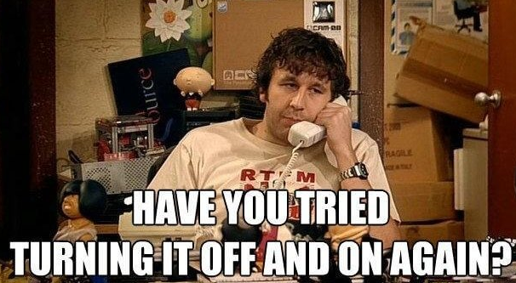
The Trouble With Cloud Dependent EDR
Cloud dependent EDR requires network.
If it can’t call home, it can’t alert. It also can’t think
Netsh adv firewall
Blackhole DNS
Disable network interface (have you tried turning it off and on again?)
Just uninstall (Cylance Optics)

Slide 15

Defender ATP Cloud Comms
Domain: *.Microsoft.com
Port 443
Turn off the interface
Most AI is online not on box
Notes:
How will you be able to alert if you don’t have a network!

Slide 16
Cut off the brain and the body dies
Netsh adv firewall deny
Host file black hole entries for ATP domains (potentially flagged)
Null routing
Disable interface

Slide 17
WMI WTF?!
WMI still seems to be the sweet spot mostly
Powerful interfaces allow more privileged controls
What you can’t do in the CLI you can do in WMI (most of the time)

Slide 18
Unmanaged Code
Risky Windows API calls get flagged
Same action using unmanaged C++ flew under the radar using ntdll instead of advapi.
MS denied taking the easy way out on this, but our testing results were contrary to their assertions.
Best guess is ATP has built-in hooks into the IL interpreter. (or at least the C# aspect of it.)
Silent Trinity by @byt3bl33d3r is testing these boundaries. We HIGHLY recommend checking it out if you haven’t yet.
https://github.com/byt3bl33d3r/SILENTTRINITY

Slide 19
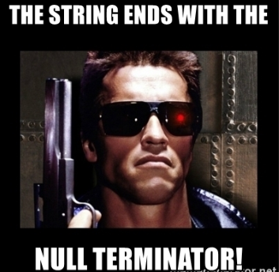
Alternative Registry Run KEys
Run keys have been burned.
Null byte reg values sometimes overlooked
Hijack existing startup binary

Slide 20

Fighting Dirty
Kill the running processes
Stop or delete the service
Overwrite the folder/binary/driver with garbage
Get by with a little help from Cylance
ACLS DACLS and ICACLS oh my!

Slide 21
No more Powershell
What’s old is new again
Native commands are all you need
No red flags
Walk softly & carry a small batch script
Mimic normal userland actions

Slide 22
The chinks in the armor
Filesystem
Service objects
Registry objects

Slide 23
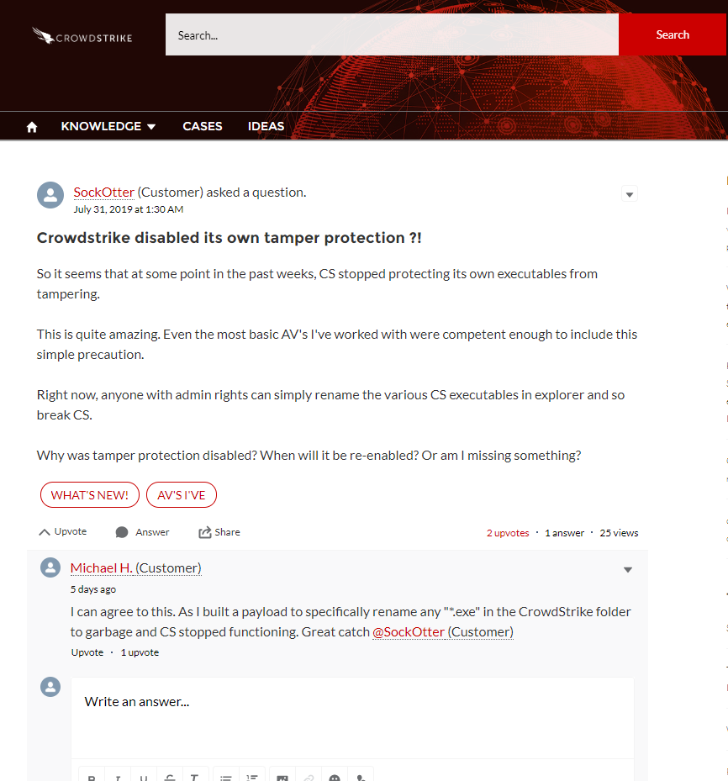
And some of them Know it…

Slide 25
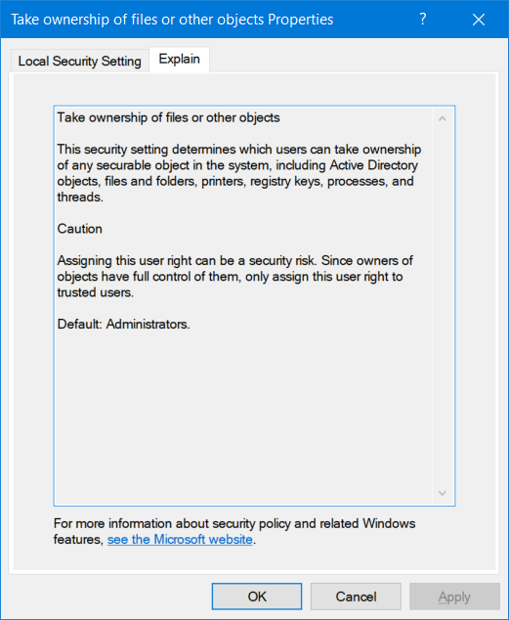
Take Ownership
Ability to take ownership of a file, service, registry object.
Anything with an ACL has an owner.

Slide 26

So easy EVEN HR can do it
Takeown / icacls one liners
Bat files

Slide 27
takeown /R /A /F \"C:\\Program Files\\Windows Defender Advanced Threat Protection\" /D N &&
icacls \"C:\\Program Files\\Windows Defender Advanced Threat Protection\" /grant Everyone:F /T /C
reboot - rename/Delete - reboot
what if?
icacls \"C:\\Program Files\\Windows Defender Advanced Threat Protection\" /Deny System:F /T /C
Reboot

Slide 28
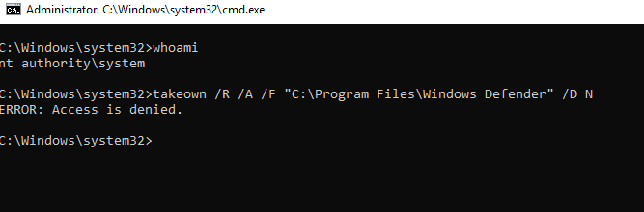




Update…
Windows Defender files and directories are no longer unprotected.

Slide 29
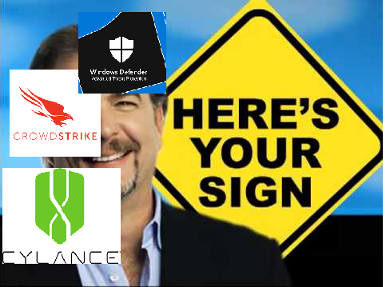
Silly things vendors do

Slide 30
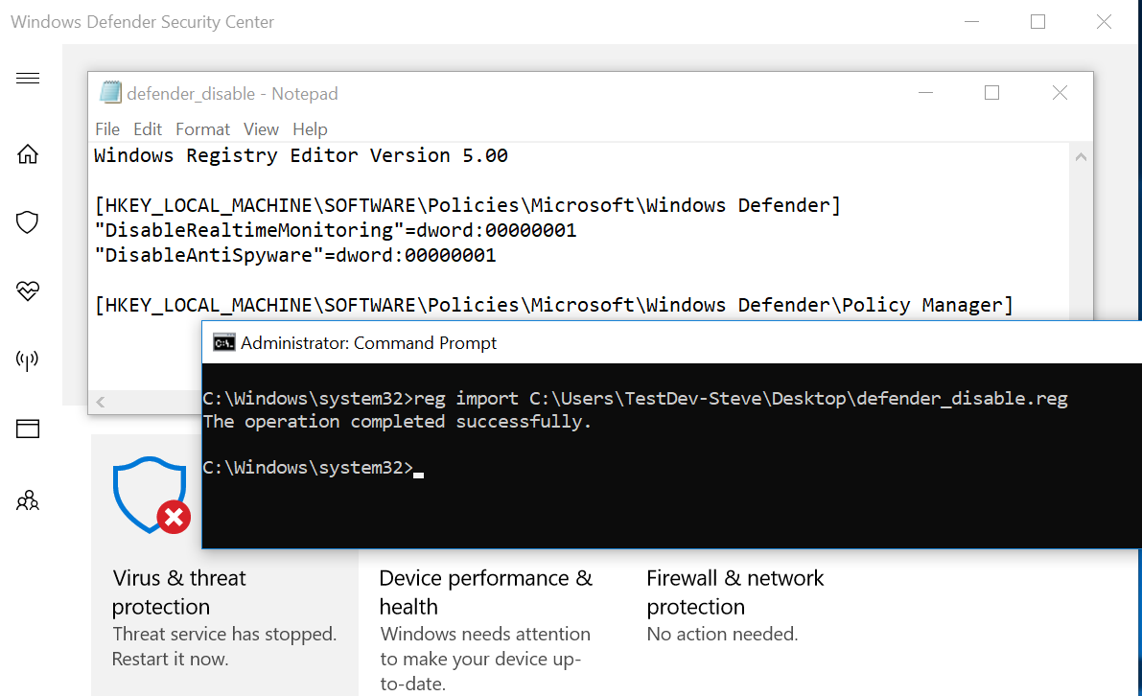
Windows Defender has hardened their directories. But...

Slide 31
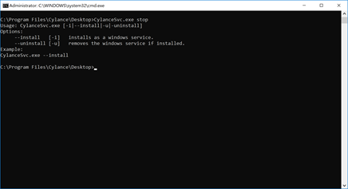
Cylance Fails
https://medium.com/@_graphx/how-i-got-cylance-to-commit-seppuku-c1f18689be1b

Slide 32
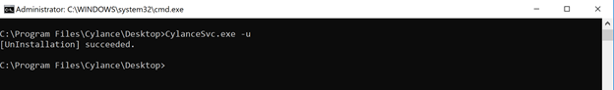
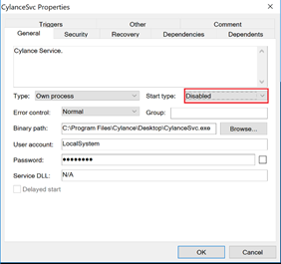

Slide 33
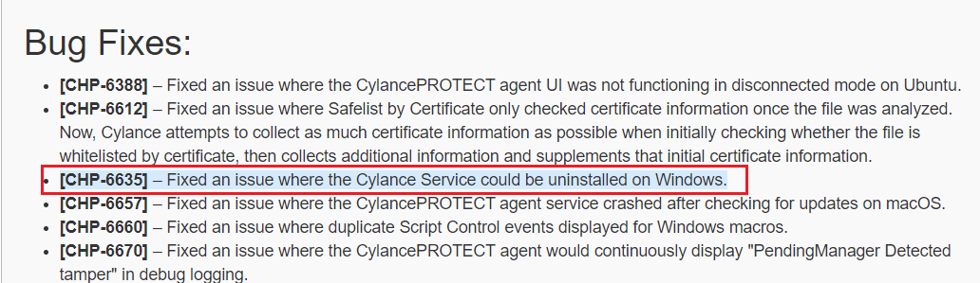
POC Script: https://gist.github.com/Graph-X/86ba7e7fe31c435005625354930ac5a5

Slide 34
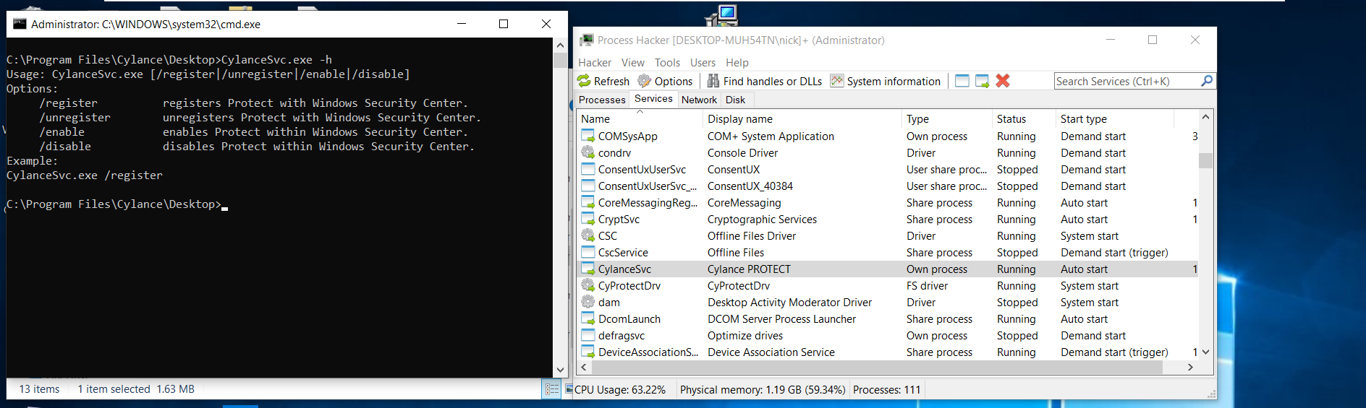

Slide 35
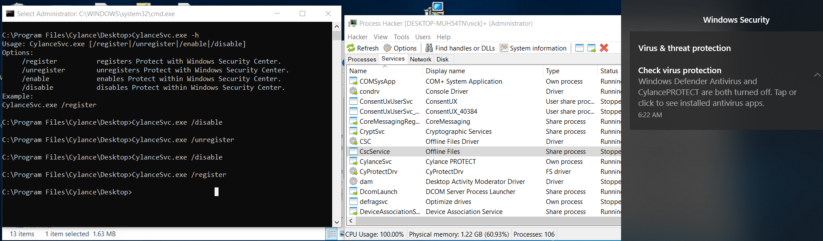

Slide 36
CONCLUSIONS
NG-AV and EDR have really upped their game on fancy evasion techniques
Mimic userland activities
Traditional AV is doing self-protection better
C++ is the old new hotness
Soft spots are registry, filesystem and service acls.
Log and filter NTFS activities
Do you really need SETakeOwnership?

Slide 37
Questions/Drinks

